Slide 1
Digital Portfolio
STUDENT NAME: Ganasri
REGISTER NO AND NMID:2422K0187 & asbru3124cs02
DEPARTMENT: B.Sc CS
COLLEGE: Cheran Arts Science College

Slide 2
PROJECT TITLE
FitForge Pro

Slide 3


AGENDA
Problem Statement
Project Overview
End Users
Tools and Technologies
Portfolio design and Layout
Features and Functionality
Results and Screenshots
Conclusion
Github Link
3/21/2024 Annual Review

Slide 4

PROBLEM STATEMENT
💡 Problem Statement Many people struggle to maintain a consistent workout routine due to lack of structure, motivation, or time. FitForge Pro solves this by offering a guided, interactive experience that adapts to the user's goals and schedule.

Slide 5

PROJECT OVERVIEW
🎯 Project Overview FitForge Pro is a responsive, browser-based fitness app that generates personalized workout routines based on user preferences. It includes built-in timers, rest intervals, motivational quotes, and streak tracking to encourage consistency and engagement. Designed with a clean UI and mobile-first approach, FitForge Pro empowers users to stay active without needing a gym or trainer.

Slide 6

WHO ARE THE END USERS?
👨‍💼 Professionals
👩‍🎓 Students
🏃‍♂️ Fitness Enthusiasts
👩‍💻 Remote Workers
🧘 Mindfulness Practitioners
👨‍👩‍👧‍👦 Families
🧑‍🦳 Seniors
🧑‍🦽 People with limited mobility 📱 Mobile Users
🌍 Global Audience

Slide 7

TOOLS AND TECHNIQUES
🧱 HTML : HTML provides the structure of your app.
🎨 CSS : CSS handles the presentation and layout
⚙️ JavaScript : JavaScript powers the interactivity and logic.

Slide 8
POTFOLIO DESIGN AND LAYOUT
Section | Purpose
Hero Section | Catch attention with branding, tagline, and visual identity
Project Overview | Summarize the app’s purpose and value
Problem & Solution | Frame the challenge and how FitForge Pro solves it
Features Showcase | Highlight core features with visuals and descriptions
UI/UX Design | Display design decisions, wireframes, and responsiveness
Tech Stack | Show technologies used with icons or badges
Demo & Screenshots | Provide interactive demo or static previews
Challenges & Learnings | Share development hurdles and how you overcame them
Future Roadmap | Outline planned enhancements or scalability ideas
Contact & Links | Invite collaboration or feedback with links to GitHub, LinkedIn, etc.
8

Slide 9
FEATURES AND FUNCTIONALITY
Features And Functionality :
- 🎯 Workout Generator: Choose type (cardio, strength, flexibility) and duration
- ⏱️ Timers & Rest Intervals: 30s exercise + 15s rest with live countdown
- 💬 Motivational Quotes: Random quote to inspire each session
- 🔥 Streak Tracker: Tracks daily workout streak using localStorage
- 📱 Responsive Design: Optimized for mobile and desktop
- 🎨 Modern UI: Clean, intuitive interface with clear hierarchy

Slide 10
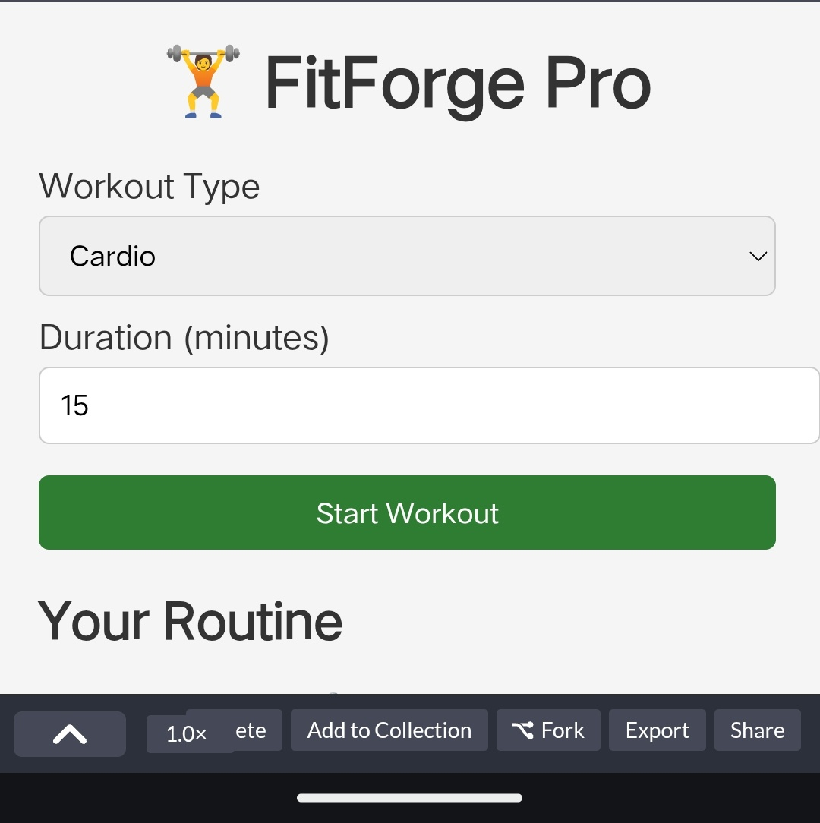

RESULTS AND SCREENSHOTS
3/21/2024 Annual Review
10

Slide 11
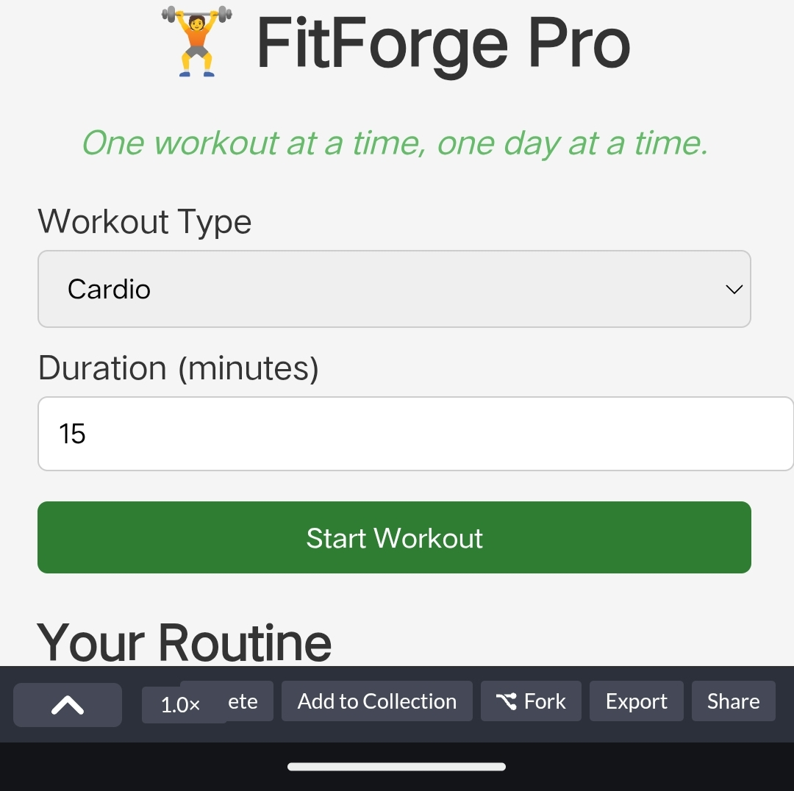
RESULTS AND SCREENSHOTS
3/21/2024 Annual Review
11

Slide 12
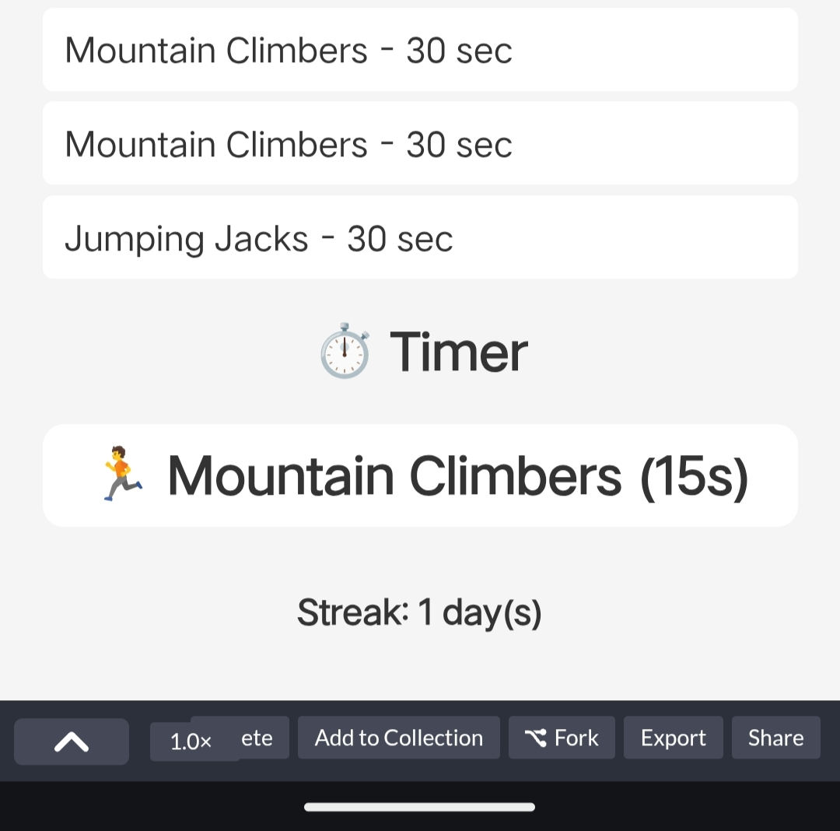
RESULTS AND SCREENSHOTS
3/21/2024 Annual Review
12

Slide 13
CONCLUSION
✅ Conclusion: FitForge Pro – Smart Fitness CompanionFitForge Pro stands as a testament to how simple web technologies can deliver powerful, user-centric solutions. By combining personalized workout generation with interactive timers, motivational support, and habit tracking, this project transforms the browser into a fitness coach—accessible to anyone, anywhere.
Its clean design, responsive layout, and thoughtful features make it not just a tool, but a daily companion for users seeking consistency and motivation in their fitness journey.
Whether you're a student, a remote worker, or a seasoned athlete, FitForge Pro adapts to your goals and keeps you moving forward.This project showcases the potential of front-end development to solve real-world problems with elegance and empathy—and it lays the foundation for future enhancements like voice control, calendar integration, and mobile app deployment.FitForge Pro isn’t just code—it’s commitment, creativity, and care, built into every rep. 💪
13

